Slide 1
New
ODF Toolkit from TDF
Svante Schubert
TIRANA | 11 Sept. 2019

Slide 2
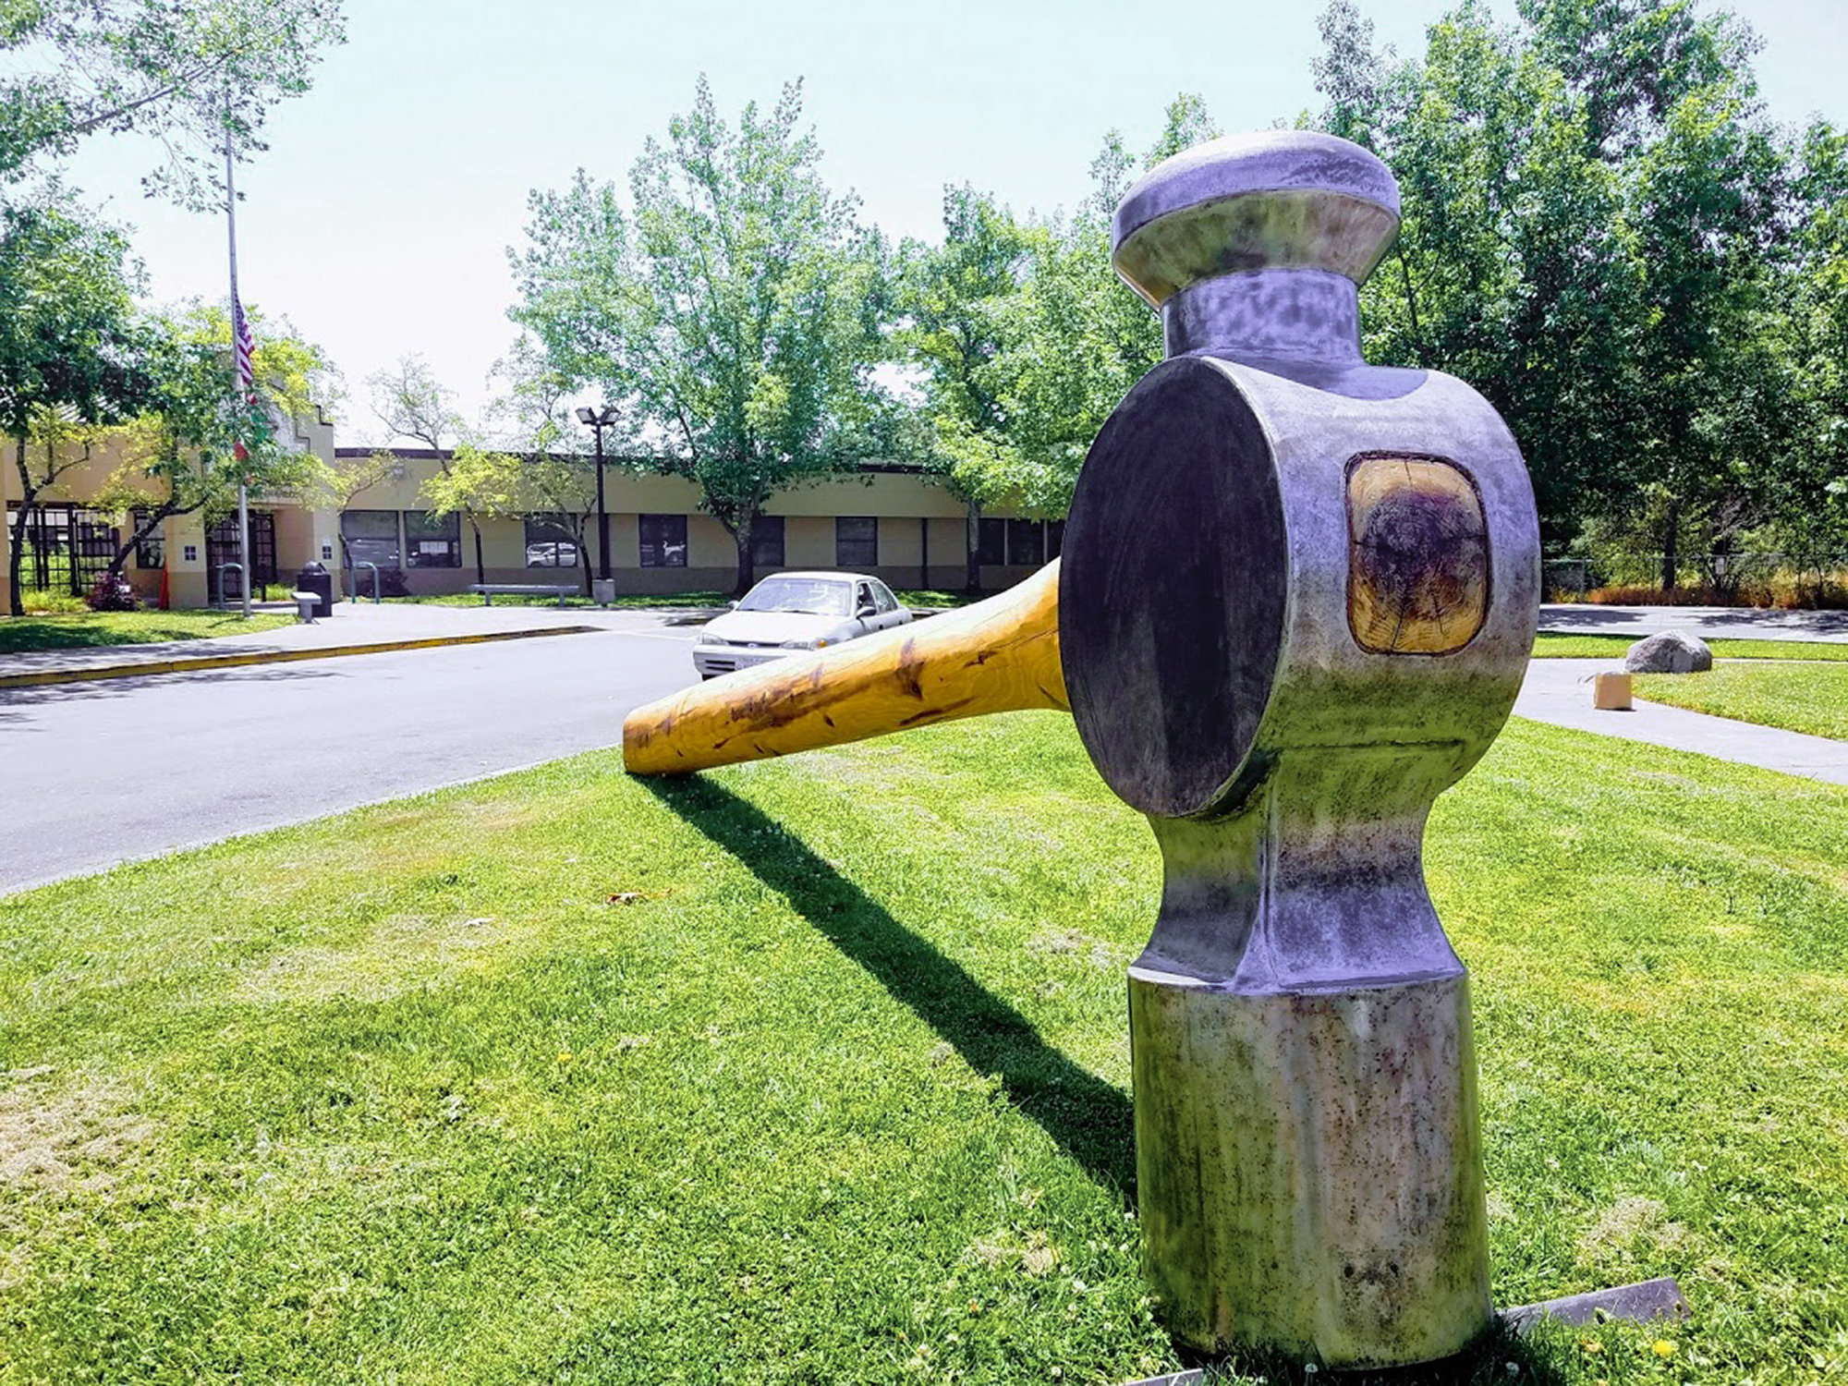
ODF Toolkit?
What for?
800 pounds sculpture (was stolen) from Healdsburg, Calif.
Notes:
<Foliennummer>
Not a silver bullet, but a BIG hammer :-)
Even a toolkit, therefore a set of tools…
Tools meant for ODF Developers

Slide 3

ODF Toolkit
ODF Basic
ODF document is a ZIP:
                ODF Package
                (part 3)
                ODF XML
                (part 1)
OASIS ODF specification ==
„Blueprint“ or „Cooking Recipe“
Notes:
<Foliennummer>
ODF Package is defined by:
OASIS specification part 3
XML Manifest (content table),
encryption,
signature
ODF XML is defined by:
OASIS specification part 1:
XML (content,styles,meta) files

Slide 4
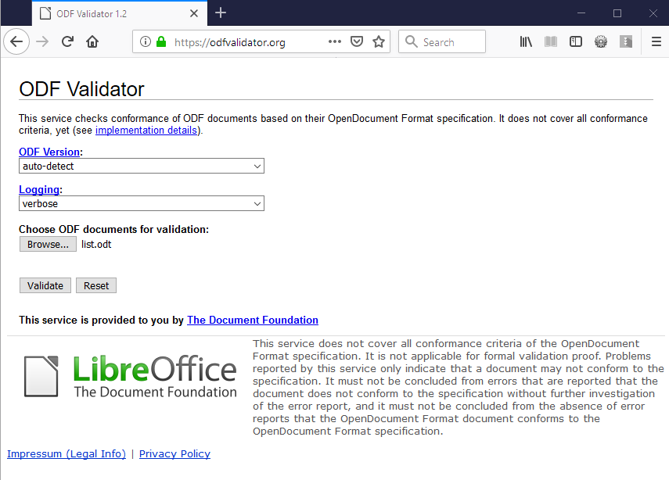
Notes:
<Foliennummer>
The onl y tool with a GUI is the ODF Online Validator..
See odfvalidator.org
Coming with GUI and validator bundled as a JEE WAR (Web Archive) easily to be added to a a Web Application Server, such as Apache Tomcat

Slide 5
ODF Toolkit
Use Cases
Online Validator (or via commandline)
https://odfvalidator.org/
Running XSLT directly on ODF document (no unzipping XML)
Notes:
<Foliennummer>
- The ODF validator is hosted by TDF the Document Foundation!
- Who knows XSLT? Running on the zipped XML within the ODF without the need to unzip the files.
- Main Module ODFDOM:
ODF manipulation by API on server
A) New Data in templates
Create ODF from Database:
B) Exchanging Data:
1. Get visible text – 2. translate – 3. exchange existing text!
- COLLABORATION with ODFDOM (soon with 1.0.0)

Slide 6
ODF Toolkit
Use Cases
Editing an ODF document (e.g. Cloud)
  by API without Layout
  for Data Extraction (e.g. Translation)
  for Data Insertion (e.g. by Database)
Collaboration on Documents (ODT)
  backend for Web Offices (ODT)
  (starting with ver 1.0.0)
Notes:
<Foliennummer>
- The ODF validator is hosted by TDF the Document Foundation!
- Who knows XSLT? Running on the zipped XML within the ODF without the need to unzip the files.
- Main Module ODFDOM:
ODF manipulation by API on server
A) New Data in templates
Create ODF from Database:
B) Exchanging Data:
1. Get visible text – 2. translate – 3. exchange existing text!
- COLLABORATION with ODFDOM (soon with 1.0.0)

Slide 7
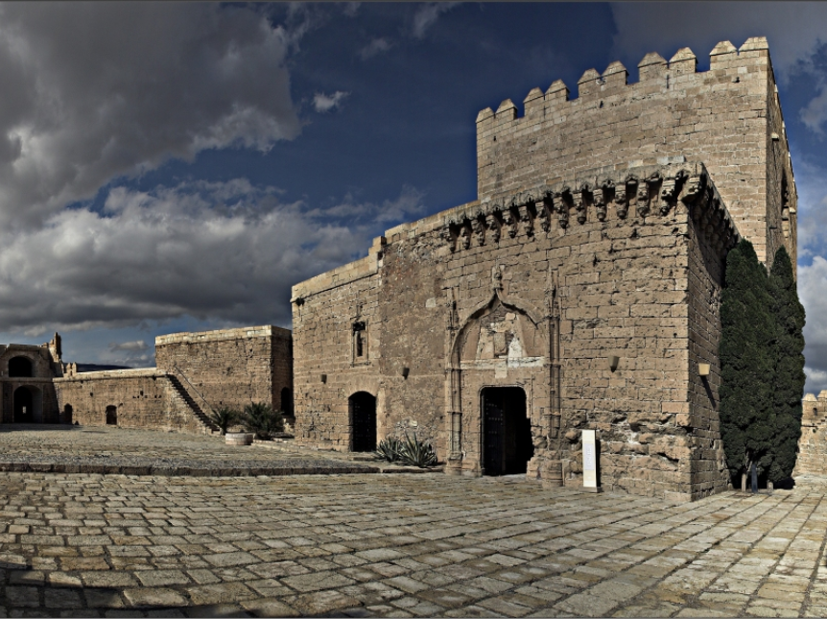
The
Architecture of
ODF Toolkit
The Architecture of ODF Toolkit
Alcazaba of Almería
Notes:
<Foliennummer>
Similar to buildings – here the Alcazaba of Almeria – architecture matter for software.
Starting with the modules of the ODF Toolkit

Slide 8
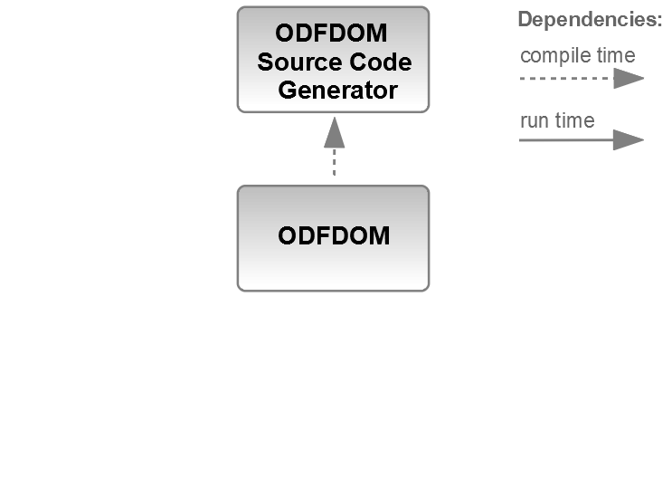
ODF Toolkit
Architecture
Notes:
<Foliennummer>
Similar to JAXB for W3C schema (grammar).
(Java XML Binding of JEE, works only for W3C schema)
The ODF grammar/schema is used to generate Java sources.
Every ODF element and attribute is created as a typed Java DOM class in ODFDOM to ease developer to create valid ODF.
In the future, likely a second approach in RUST?
Allowing multi-threading and better memory handling.

Slide 9
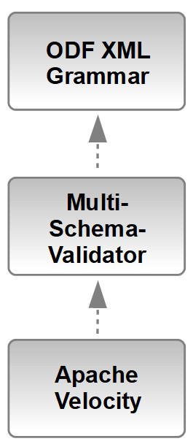
ODFDOM
Source Code
Generator
Architecture
OASIS XML grammar: ~18000 text lines
~600 XML elements
~1200 XML attributes
XML Valdiator -
reads many
XML grammars
template engine generating sources
by text templates having a context with Java access
Notes:
<Foliennummer>
In the very first approach XSLT was used to create from the ODF XML grammar the Java sources.
We split the complexity and
reused existing opensource software:
a) Multi-Schema-Validator (MVS)
to read the XML grammar
b) Apache Velocity Engine as Template engine
With ODF Toolkit 1.0.0 introduced common tree data structure to allow other tooling on the XML grammar

Slide 10

ODF GrammaR - text hard to Answer
Can a
paragraph <text:p>
be nested
in a valid document?
🤔🙄
ODF 1.2 XML:
598 XML Elements
1300 XML Attributes
>18k lines
Notes:
<Foliennummer>
<Foliennummer>
- Grammar hard to understand
- Only basic set of information to define changes
- hard to standarizse changes
- Analysis difficult..

Slide 11
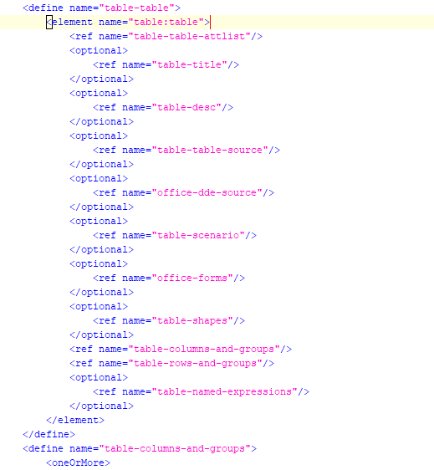
ODF Grammar - text hard to read
ODF 1.2 XML:
598 XML Elements
1300 XML Attributes
>18k lines
Notes:
<Foliennummer>
<Foliennummer>
- Grammar hard to understand
- Only basic set of information to define changes
- hard to standarizse changes
- Analysis difficult..

Slide 12
ODF GrammaR - text hard to read
<define name="table-table">
<element name="table:table">
<ref name="table-table-attlist"/>
…
<optional>
<ref name="text-soft-page-break"/>
</optional>
<ref name="table-table-row"/>
ODF 1.2 XML:
598 XML Elements
1300 XML Attributes
>18k lines
Notes:
<Foliennummer>
<Foliennummer>
- Grammar hard to understand
- Only basic set of information to define changes
- hard to standarizse changes
- Analysis difficult..

Slide 13

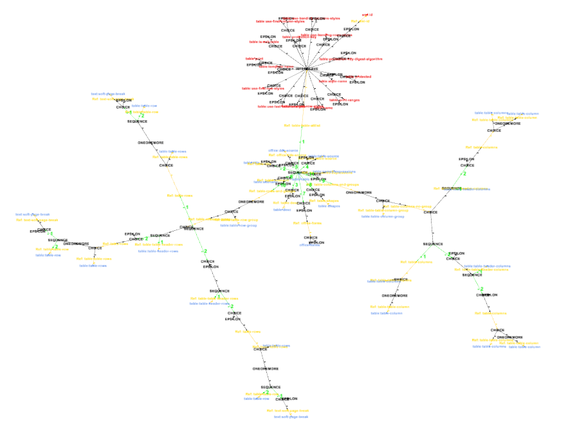

ODF GrammaR - Graph tabel Element with children
Notes:
<Foliennummer>
<Foliennummer>
- https://groups.google.com/forum/#!searchin/gremlin-users/svante%7Csort:date/gremlin-users/P8MdzzlFtng/vYqYlukJAgAJ

Slide 14
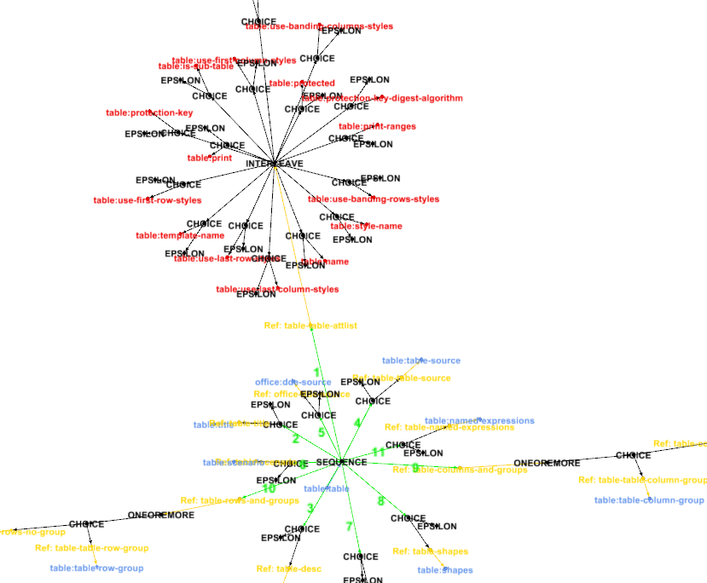
ODF GrammaR - Graph tabel Element with children
Notes:
<Foliennummer>
<Foliennummer>
- https://groups.google.com/forum/#!searchin/gremlin-users/svante%7Csort:date/gremlin-users/P8MdzzlFtng/vYqYlukJAgAJ

Slide 15
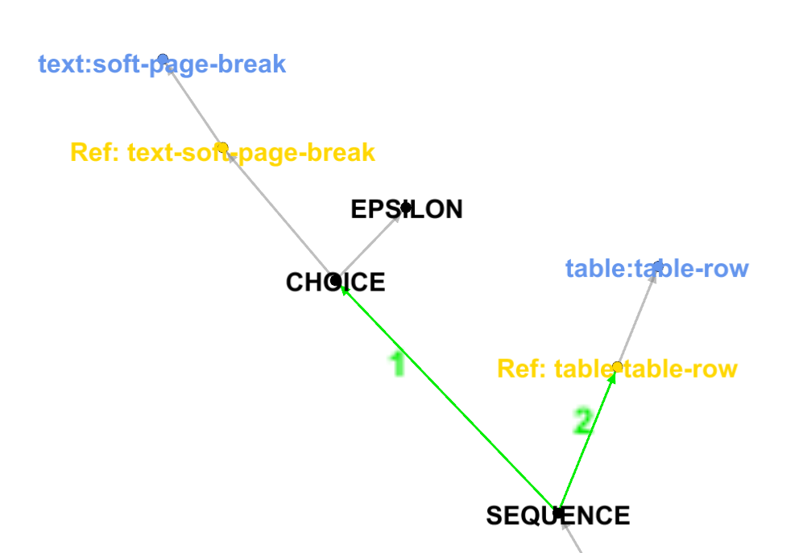
ODF Grammar - Graph hard to read
Notes:
<Foliennummer>
<Foliennummer>
- https://groups.google.com/forum/#!searchin/gremlin-users/svante%7Csort:date/gremlin-users/P8MdzzlFtng/vYqYlukJAgAJ

Slide 16
ODF Grammar - Graph simplified
text:soft-page-break
text:table-row
2
1
SEQUENCE
Notes:
<Foliennummer>
<Foliennummer>
Gremlin is worth the name, incredible time spending learning Gremlin Graph language to execute this simplification step..

Slide 17
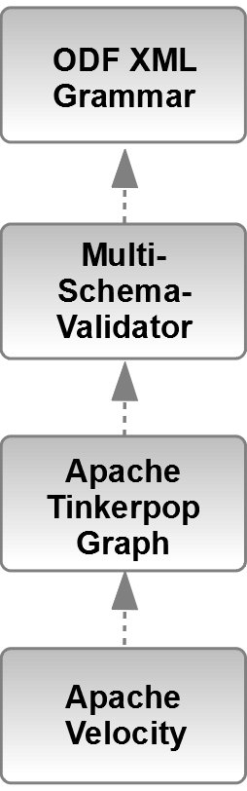
ODFDOM
Source Code
Generator
Architecture
OASIS XML grammar: ~18000 text lines
~600 XML elements
~1200 XML attributes
XML Valdiator -
reads many
XML grammars
Graph of
XML grammar
(since 1.0.0)
template engine - generating sources
by text templates having a context with Java access
Notes:
<Foliennummer>
In the very first approach XSLT was used to create from the ODF XML grammar the Java sources.
We split the complexity and
reused existing opensource software:
a) Multi-Schema-Validator (MVS)
to read the XML grammar
b) NOW with a GRAPH representation of the
ODF grammar
c) Apache Velocity Engine as Template engine
With ODF Toolkit 1.0.0 introduced common tree data structure to allow other tooling on the XML grammar

Slide 18
ODF Toolkit
Architecture
Notes:
<Foliennummer>
Similar to JAXB for W3C schema (grammar).
(Java XML Binding of JEE, works only for W3C schema)
The ODF grammar/schema is used to generate Java sources.
Every ODF element and attribute is created as a typed Java DOM class in ODFDOM to ease developer to create valid ODF.
In the future, likely a second approach in RUST?
Allowing multi-threading and better memory handling.

Slide 19
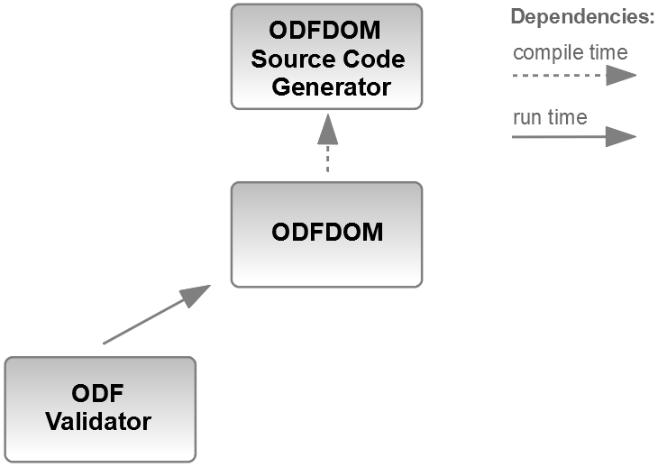
ODF Toolkit
Architecture
Notes:
<Foliennummer>
ODF Validator relies on ODFDOM
The ODF document is loaded by ODFDOM and error messages are gathered during loading from ODFDOM.

Slide 20
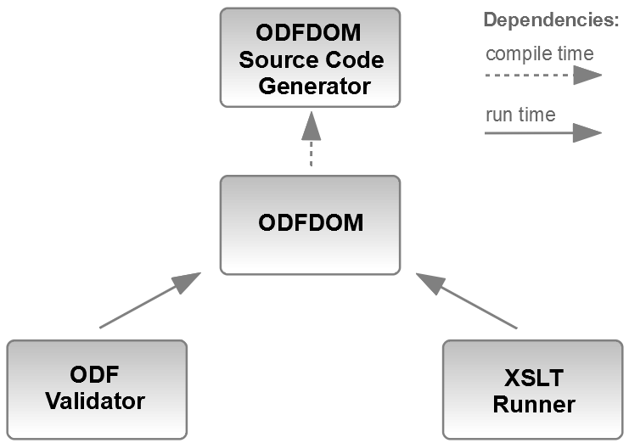
ODF Toolkit
Architecture
Notes:
<Foliennummer>
XSLT Runner relies on ODFDOM
The ODF document is loaded by ODFDOM and the XML streams are provided to the XSLT processor, references within the XML resolved into the ZIP.

Slide 21
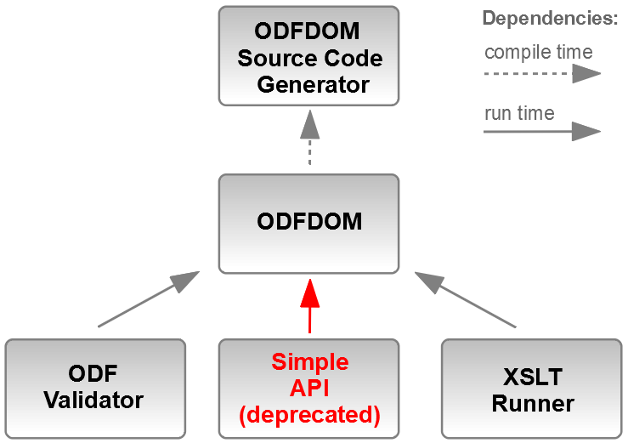
ODF Toolkit
Architecture
Notes:
<Foliennummer>
The Simple API was a fork by IBM, but back joint with the ODF Toolkit at Apache.
The Simple API correct idea was to provide a high level user API not on the XML, but on the uers‘s semantics.
But it includes too much duplicated code from ODFDOM and was therefore deprecated in 0.9.0 and will not be part of 1.0.0
In addition, much more should be generated in ODFDOM instead written manually.

Slide 22
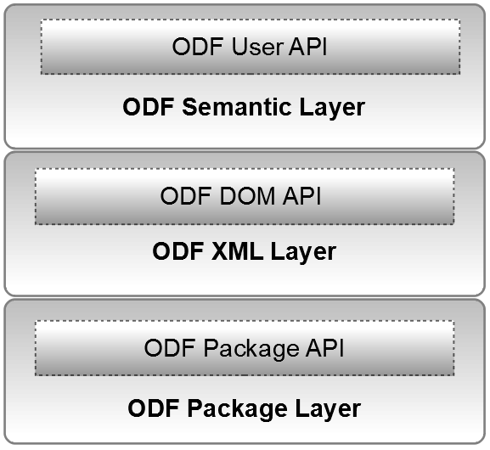
ODFDOM
Architecture
3.
2.
1.
Notes:
<Foliennummer>
1. The lowest first API is the Package API.
Taking care of unzipping, add/read/delete ZIP‘s content and updating content table.
[NOTE: PKG API NOT OWN JAR DUE TO
HARD CODED DOC LOADER DETECTION]
Providing:
a) Document support (being a directory with MIME TYPE in ODF)
b) XML support (access and caching the DOM)
2. DOM API is generated from the ODF XML Schema, should contain all implementation details and providing the corsett of XML validness#
3. User API currently hand written (in future mostly generated) should provide all functionality from easy user semantic perspective by accessing the underlying layers.

Slide 23
ODFDOM
Architecture (in spe)
3.
public
2.
private
1.
Notes:
<Foliennummer>
Unfortunately ODF applications do not have an interoperable RunTime Environment, like browsers having the DOM Model, which is the reason that JavaScript works across different browsers and ACID tests work (loading document shows level of support).
LibreOffice knows nothing about XML after loading.
There is a much better interoperability over semantic.
Every ODF applications allows add/modify/delete the same semantic entities (like paragraph, character, table, image, etc.) and their properties (bold, color, border width, etc.), we are working out the semantic model and its initial API, the User API.
Only User API should be public (or the other APIs public, but only an exchangeable implementation detail).

Slide 24
Document Collaboration from 80ths
Design based on former Requirements
In the 80ths: One person on
single machine
Exchanging document by floppy disc or modem
Notes:
<Foliennummer>
Most of today's leading document formats have their roots in the 80ths. Their design was build upon requirements of these days: to represent the document state for one single machine or to exchange a document by floppy disc or modem. Often designed for a single purpose far more narrow than their current usage. New features were often accomplished by workarounds. For example, change-tracking of any office format does not track a defined interoperable change. Only the earlier state of the changed area is stored, to be swapped back in case of rejection.

Slide 25
Document Collaboration Today
New Requirements
With Smartphones everyone has multiple machines
(Smartphone & PC/Laptop)
Exchanging documents faster via Internet, Mail, Dropbox, etc. will
not solve the merge problem!
Key Collaboration Question:
What have you changed?
Notes:
<Foliennummer>
Nowadays, with the rise of mobile devices, online collaboration is ubiquitous and creates challenges when dealing with documents designed for an environment from the 80ths.

Slide 26
Document Collaboration Idea
New Change Design
Allow collaboration functionality similar as software developers have with repositories
Exchanging changes (commits) instead of documents (repositories) via Internet, Mail, Dropbox, etc.
Solving Key Question:
What have you changed?
Notes:
<Foliennummer>
Collaboration on documents should be as powerful as for software developers working on (GIT) repositories.
Exchanging documents between editors for collaboration instead of exchanging the editors‘ changes is equivalent efficient to software developers zipping their source code repositories and exchanging those. To be able to merge the changes of other editors into a single representive document, the changes of each editor have to be known. Today, an interoperable exchange of user changes between applications is unfortunately impossbile as world wide only full documents are being specified (e.g. HTML, ODF, OOXML, Docbook, etc.).

Slide 27



Interoperable Collaboration
Exchanging ODF Changes
2nd paragraph new
ODF Application
ODF Application
2nd paragraph new
ODF Application
Notes:
<Foliennummer>
Multile users using different ODF applications exchanging no longer docs, but their changes!
Here they are already exchanging standardized OASIS ODF changes similar to semantic user changes.

Slide 28
Interoperable Collaboration
Exchanging ODF Changes
4th paragraph blue
ODF Application
ODF Application
4th paragraph blue
ODF Application
Notes:
<Foliennummer>

Slide 29
Interoperable Collaboration
Exchanging ODF Changes
2nd paragraph new
4th paragraph blue
ODF Application
ODF Application
4th paragraph blue
2nd paragraph new
ODF Application
Notes:
<Foliennummer>
ODF CHANGES next EVOLUTINOARY STEP

Slide 30


ODT Changes
sponsored by PrototypeFund
ODFDOM
ODT
Document
ODT
Changes
(full doc)
See https://github.com/svanteschubert/odftoolkit/tree/odf-changes/
Soon https://github.com/tdf/odftoolkit (1.0.0-beta)
Notes:
<Foliennummer>
Founded by the German PrototypeFund soon in ODF Toolkit 1.0.0 an ODT is transformed to its equivalent list of user changes (JSON format)

Slide 31
ODT Changes
sponsored by PrototypeFund
ODFDOM
ODT
Document
(changed)
ODT
Changes
(new)
See https://github.com/svanteschubert/odftoolkit/tree/odf-changes/
Soon https://github.com/tdf/odftoolkit (1.0.0-beta)
Notes:
<Foliennummer>
New user changes (JSON format) applied to the document can be merged into the document by ODFDOM (ver. 1.0.0) and saved back as altered ODT.

Slide 32
ODF Toolkit - ODFDOM
Upcoming Goals
Prototype of Collaboration of Editors based on ODF Changes (ODFDOM)
WYSIWYG Editors with different feature set editing same
ODT Document:
  LibreOffice (ODT)
  Emacs (Text)
  CKEditor 5 (HTML 5)
Notes:
<Foliennummer>
Svante has applied for next winter‘s PrototypeFund project to connect various front-end editors to make this idea useable by end-users.
The Emacs would load the paragraphs (as lines) and text of full featured ODT documents, editing it and saving Emacs user changes back without destroying the document.
The HTML editor CKEditor 5, which uses changes as its interior core, will be able to load, edit and save ODT files similar to Emacs without destroying unkown functionality.
LibreOffice is planned to extended by the lead of Thorsten Behrens to have a prototype for changes.

Slide 33
ODF Toolkit – CKEditor5
Upcoming Work
Build your CKEditor5 example:
git clone -b stable https://github.com/ckeditor/ckeditor5-build-classic.git
npm install
npm run build
Open local editor in browser (& add eventlistener from notes)
./sample/index.html
Notes:
<Foliennummer>
/*** INSERT-START – within ./sample/index.html */
/* 'applyOperation' event is catched */
editor.model.on('applyOperation', (eventInfo, args) => {
console.log('enventInfo: ' + eventInfo, 'args: ' + JSON.stringify(args));
} );
/*** INSERT-END */
See
https://ckeditor5.github.io/docs/nightly/ckeditor5/latest/api/module_engine_model_model-Model.html#event-applyOperation

Slide 34
ODF Toolkit – CKEditor5
Demo results in Chrome console
enventinfo[object Object] args[{"baseVersion":12,"position":{"root":"main","path":[0,6],"stickiness":"toNone"},"nodes":[{"data":"X"}],"shouldReceiveAttributes":true,
"__className":"InsertOperation"}]
index.html:48 enventinfo[object Object] args[{"baseVersion":13,
"range":{"start":{"root":"main","path"[0,3],"stickiness":"toNext"},
"end":{"root":"main","path"[0,7],
"stickiness":"toPrevious"}},"key":"italic","oldValue":null,"newValue":true,"__className":"AttributeOperation"}]
Notes:
<Foliennummer>
Here CKEditor starts to count their positions by 0, while we start as XML (and humans) with 1
These operations should be gathered by a plugin and dispatched to some (local by default) server

Slide 35
ODF Toolkit
Resources
Website (in progress):
https://odftoolkit.org/
https://tdf.github.io/odftoolkit/docs/ (latest)
Sources:
https://github.com/tdf/odftoolkit
Online Validator:
https://odfvalidator.org/
ODF Specification
http://docs.oasis-open.org/office/v1.2/os/
Notes:
<Foliennummer>

